Slide 1
Evolution of Makeup In Israel
Evolution
of
Makeup
In
Israel
Zoe Gordon, Mira Glusman, Shiri Richman

Slide 2
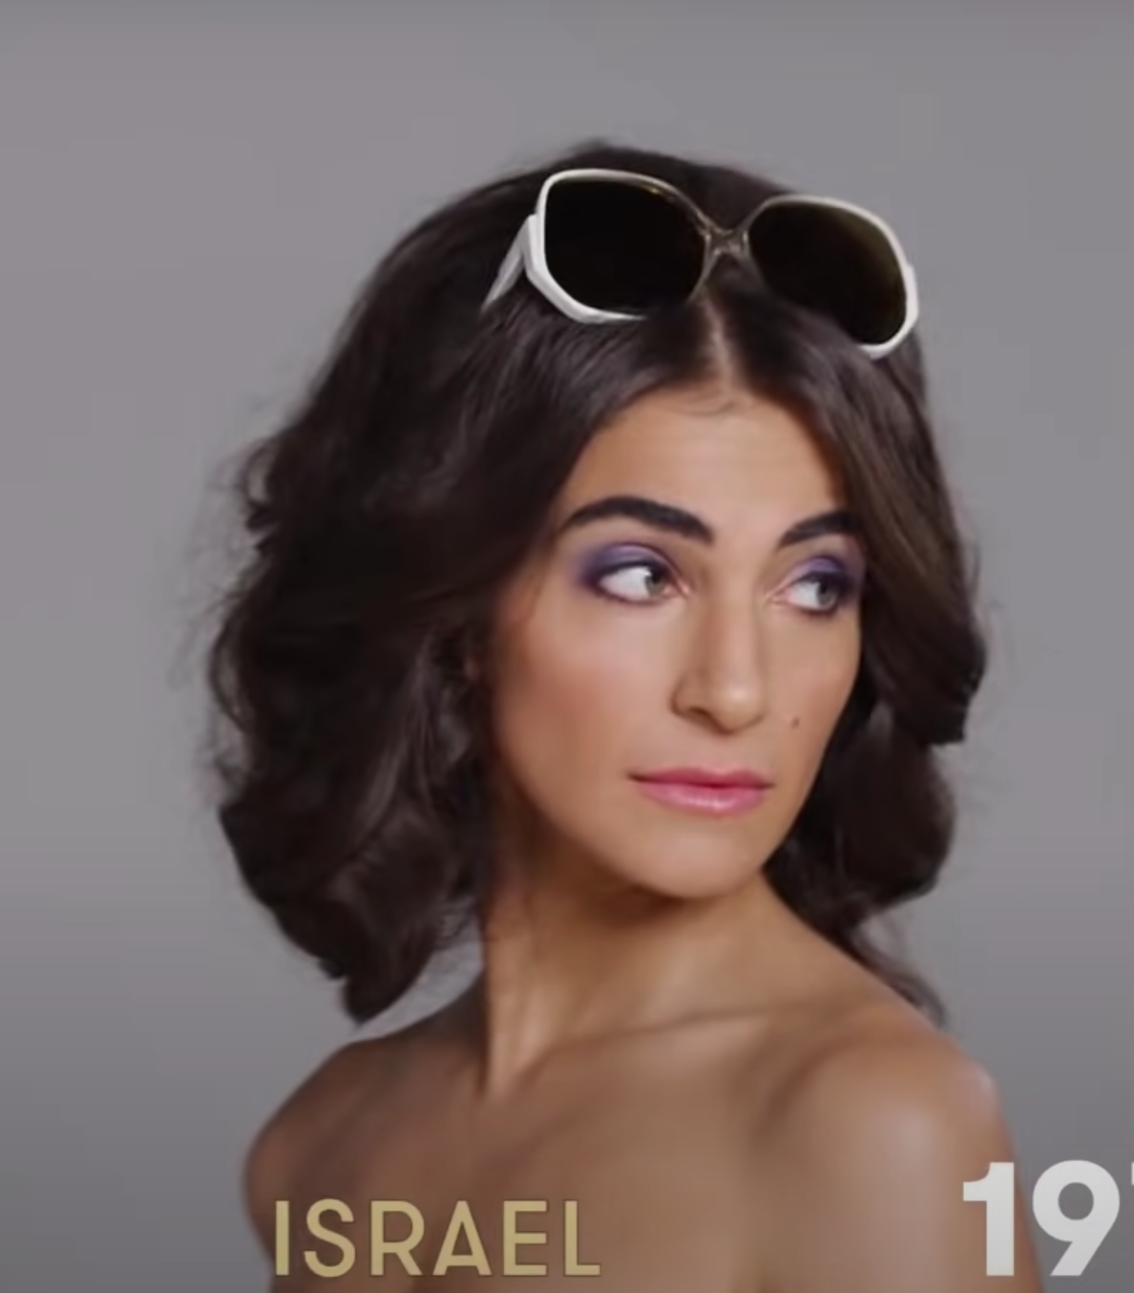
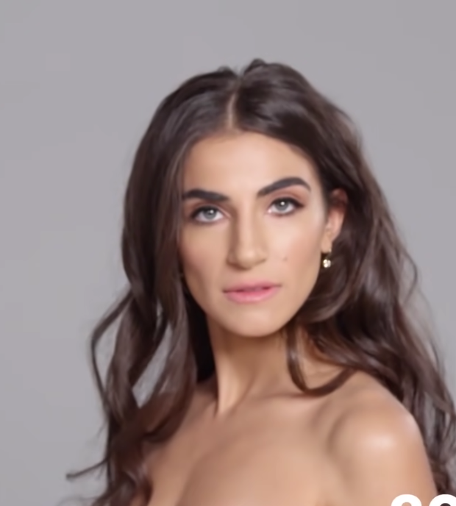
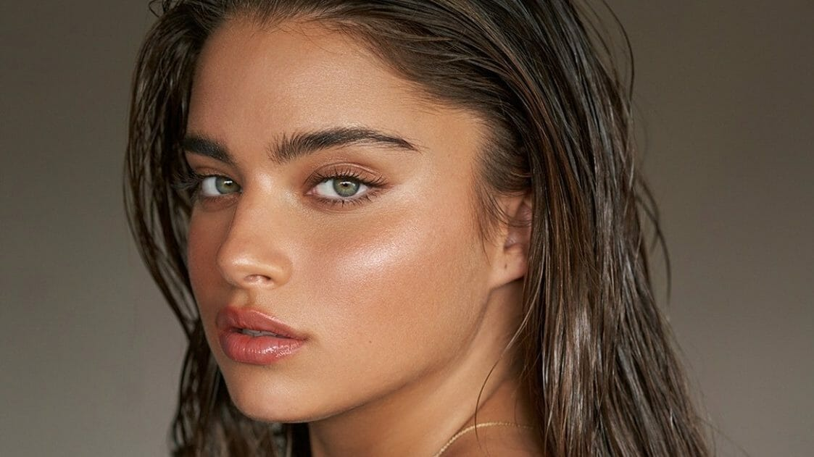
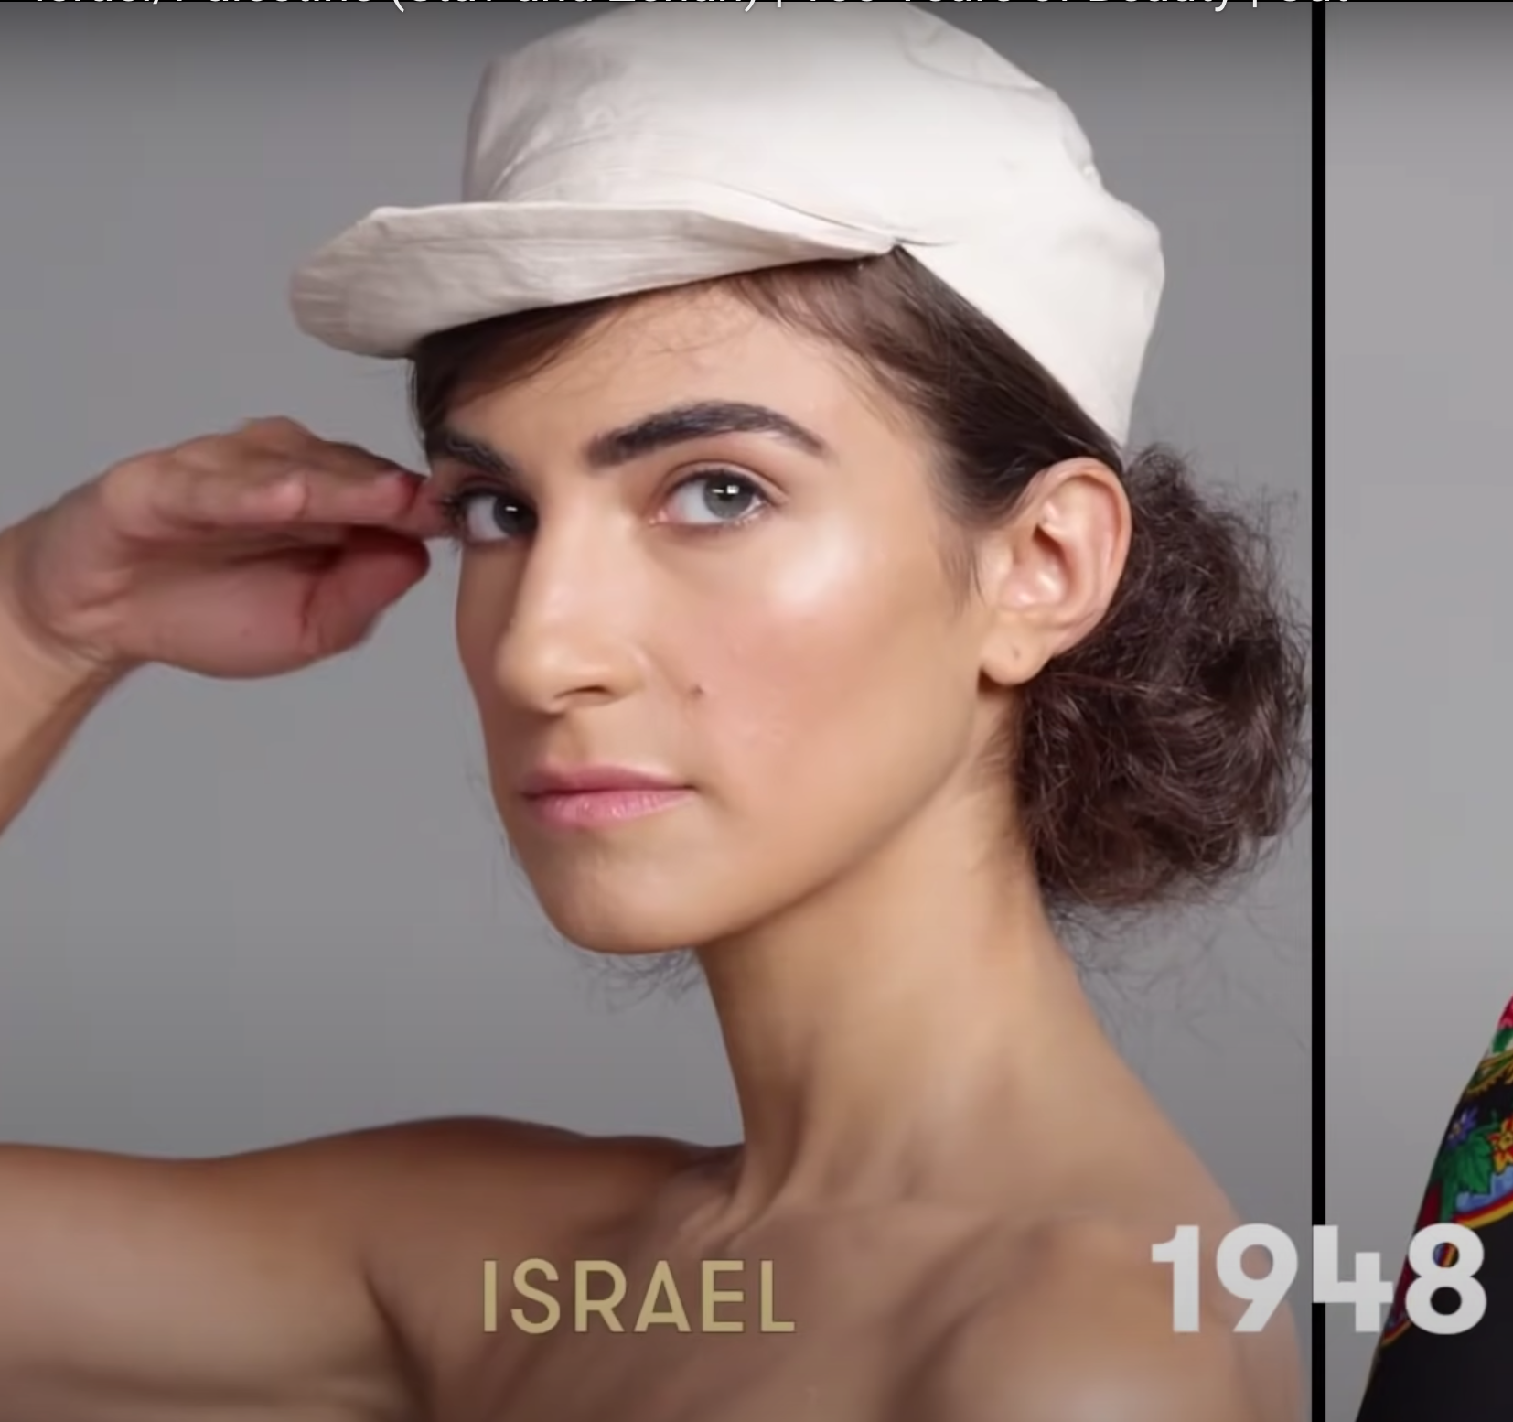
Timeline
1948
2000
2023
1948
1970

Slide 3
About the Makeup
1948: barely any makeup, more focused on eyebrows. It’s a natural look
1970: smokey eye makeup, bright colors, slightly bolder look.
2000: Also a natural look with smooth makeup.
2023: similar to american makeup, varies from bold to natural.

Slide 4
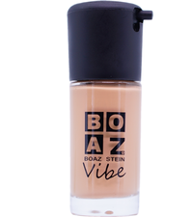
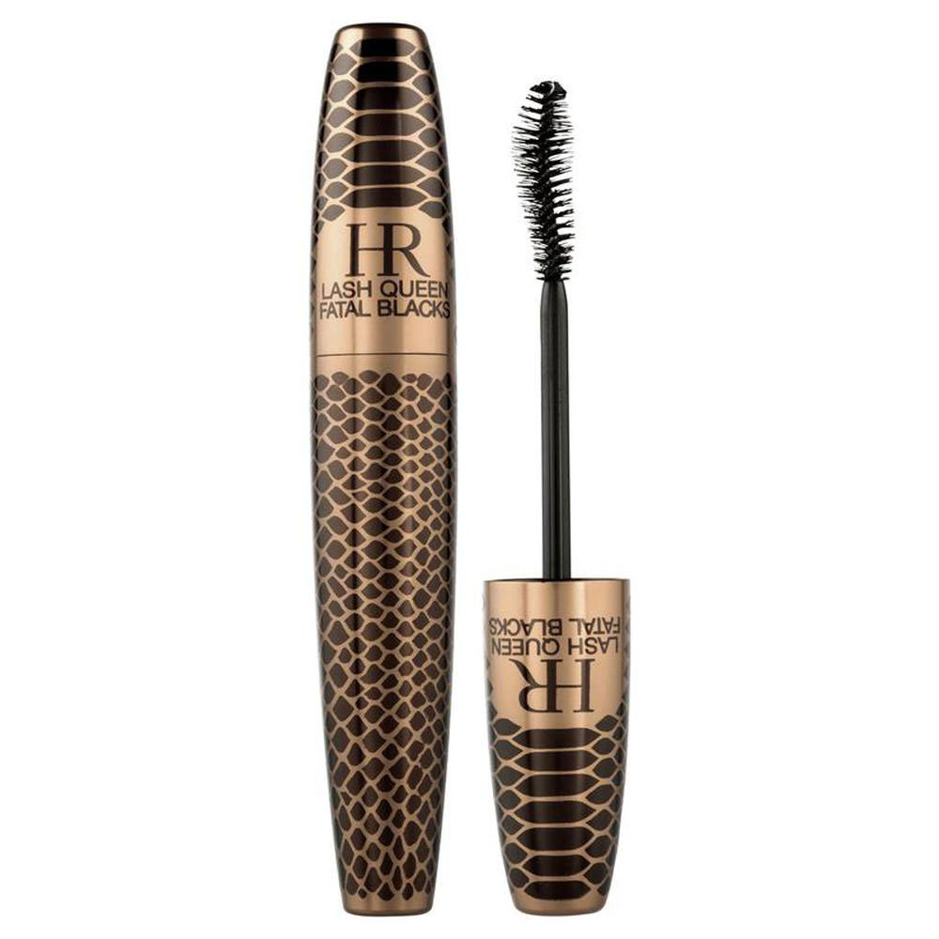
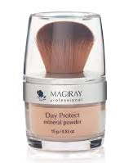
Background
For our project, we focused on the evolution of the makeup in Israel from the year of 1948 to 2023. At first, Israel’s conception of makeup was more of a natural look due to practically and survival women did not focus on wearing makeup because it was seen as a luxury. Israel followed the trends of makeup and other cosmetics from the United States, but soon after, around the 2010s, Israel started to expand their makeup horizons by creating their own Israeli makeup and cosmetic lines.

Slide 5
Sources
https://www.dailymail.co.uk/femail/article-4209952/Cut-com-charts-100-years-beauty-Israel-Palestine.html
Cut.com charts 100 years of beauty in Israel and Palestine | Daily Mail Online
https://www.youtube.com/watch?v=0L6JgyxpeCE

Slide 6
Thanks!
Thanks!
Do you have any questions?
youremail@freepik.com
+91 620 421 838
yourcompany.com
Please keep this slide for attribution

