Slide 1
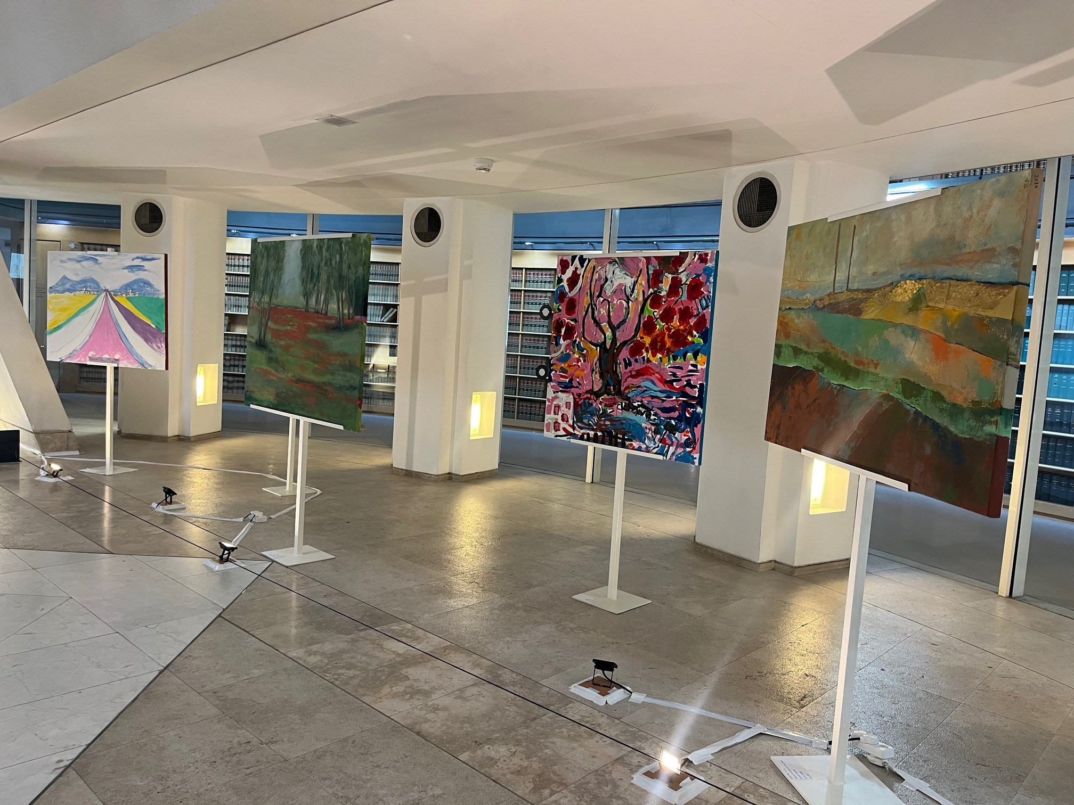
Exhibit of Artists from the Otef Gaza at the Supreme Court

Slide 2
Original Sign at Be’eri Art Gallery

Slide 3
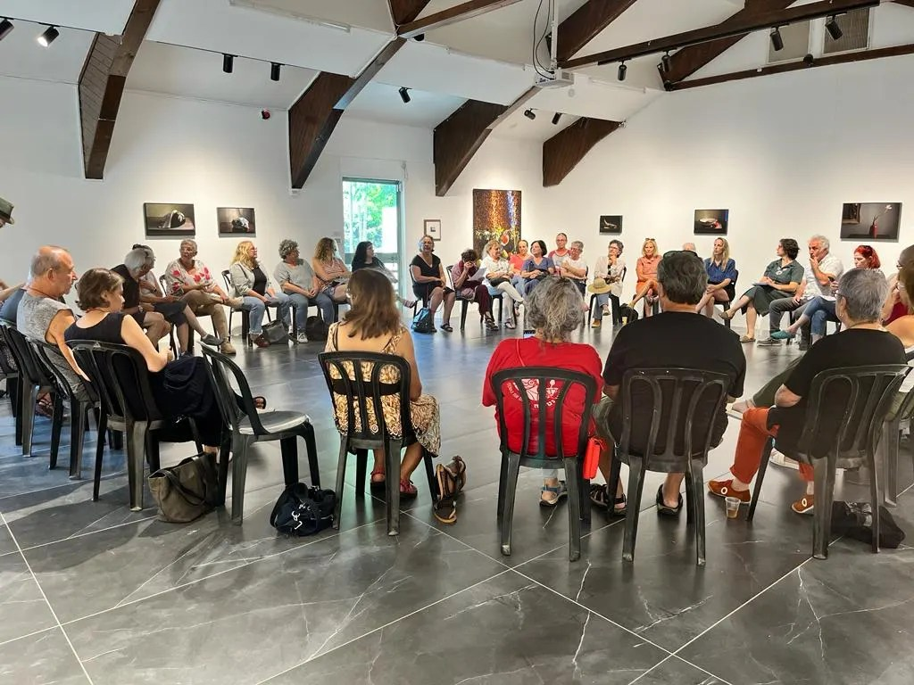
Be’eri Gallery before October 7

Slide 4
Be’eri Gallery after October 7th

Slide 5
Ziva Yellin, Curving Road This painting was saved from the Gallery and is now on display at the Israel Museum

Slide 6
Herzilya Museum of Contemporary Art— The Daily Postcard by Ze’ev (Shoshke) Engelmayer

Slide 8
Koch Family z”l Kfar Aza

Slide 9
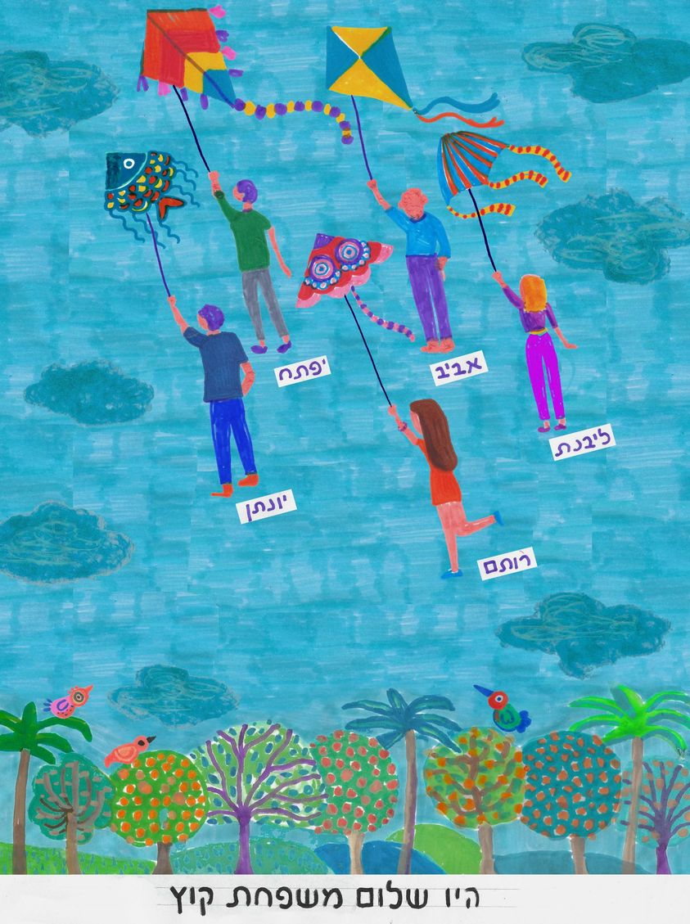
Go in peace, Koch family
Yoga lesson with Carmel Gat in Hamas captivity

Slide 10
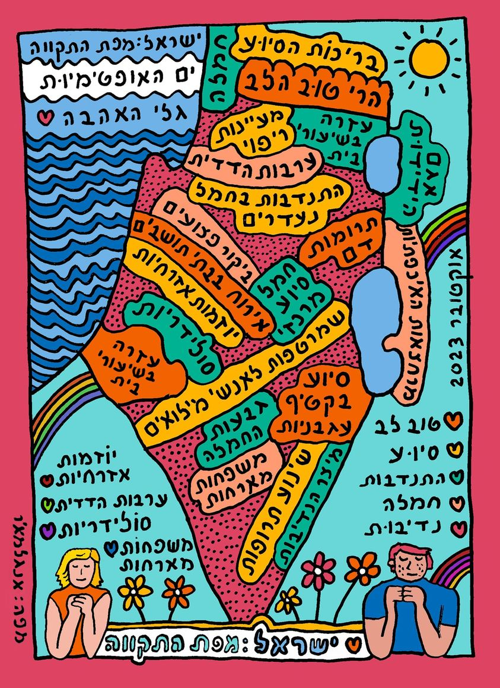
“Where were you when the siren went off?”
Israel: Map of Hope

Slide 11
Dorit Deutsch Enough, enough, enough, 100 days in captivity, a nightmare

Slide 12
Use of Installation to bring a situation to the public attention Yellow chairs—hostage square

Slide 13
Area of Kibbutz Be’eri Annual Flower Festival דרום אדום

Slide 14
Commemoration: “Poppies before the rain”

